Slide 1

LOLSCI
By: Manuel L
Here is where your presentation begins

Slide 2

About me
My name is Manuel Ledesma, I am a member of CTP’s student cohort. I was born in the Dominican Republic and emigrated here when I was 8. Since then, I’ve become a Gothamite . I received a math degree from CUNY Hostos and am currently a Senior at CUNY Lehman. Oh, I also play a lot of LOL

Slide 3
Intro to my data
The data that my project is based on is my own and of the players mentioned. All public matches/games in LOL are recorded, specially their metrics. This data is publicly available with the simple use of third party websites that use LOL’s API, but not in any sort of way that easily allows the data to be turned to a dataframe or excel sheet.
So, If I want to do data science with my own data. I have to use the API to talk the servers myself

Slide 4
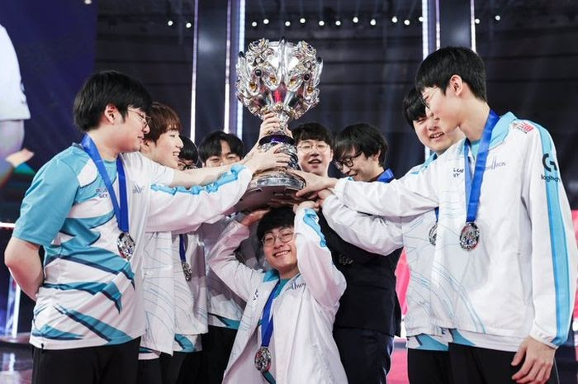

About League of Legends
LoL or ‘League of Legends’ is a game that was released around 2009. It has gone on to become one the number 1 most popular game in several countries such as Taiwan, South Korea, Turkey, etc. Currently, it is the most streamed game on Twitch and the most popular Esport game. Its parent company is Tencent.

Slide 5

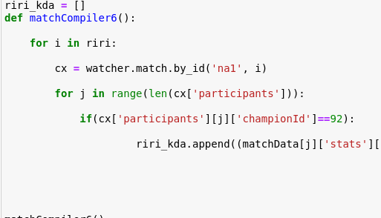
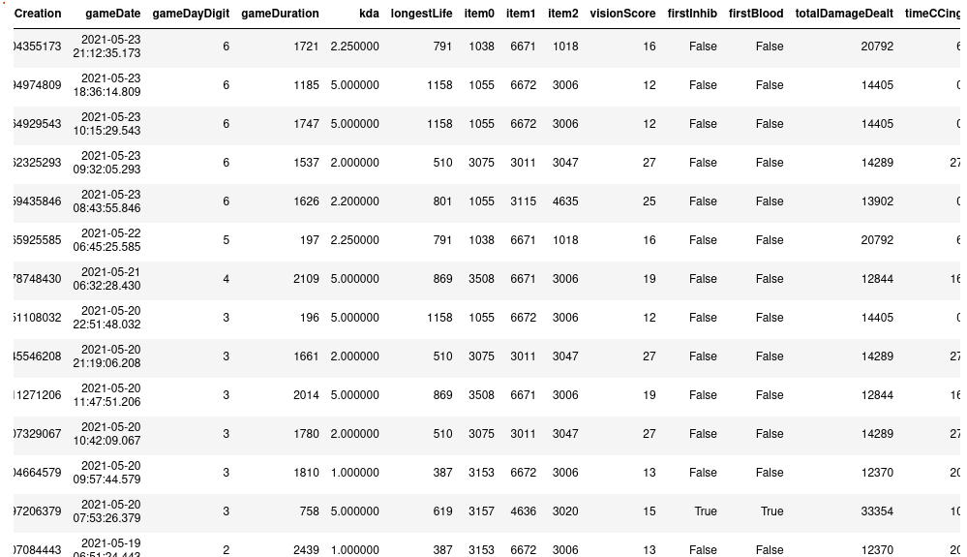
A tad more about my data
One of the bigger challenges of this project was getting the data from the api and formatting it as a dataFrame.

Slide 6




Technology used
For this project, I used:
Jupyter notebook
Python Libraries numPy, Pandas, SeaBorn, matPlotLib for EDA
The Riot API, the API used by LoL
A wrapper for the RIOT API named riotwatch

Slide 7
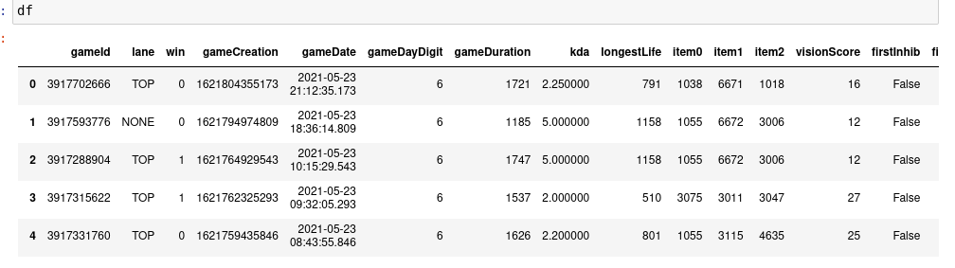
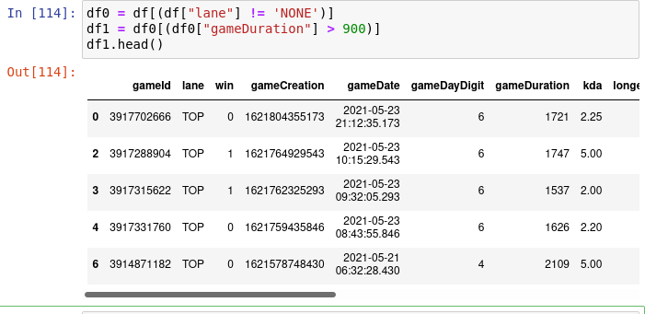
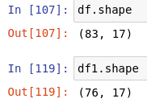
Getting rid of null rows
Removing matches that have no lane or are less than 15 minutes

Slide 8

My data

Slide 9
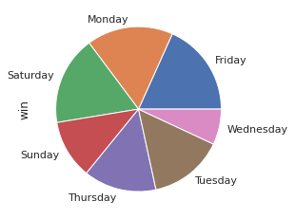
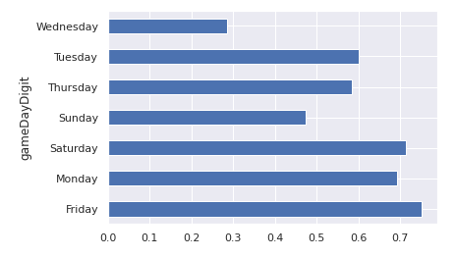
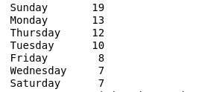
Winrate per day of week

Slide 10
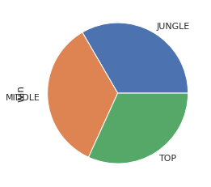
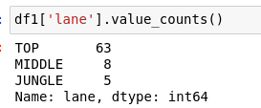
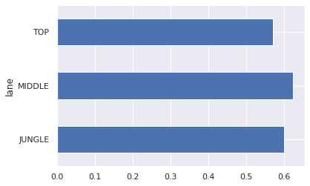
Which is my most successful lane?
Winrate per lane

Slide 11
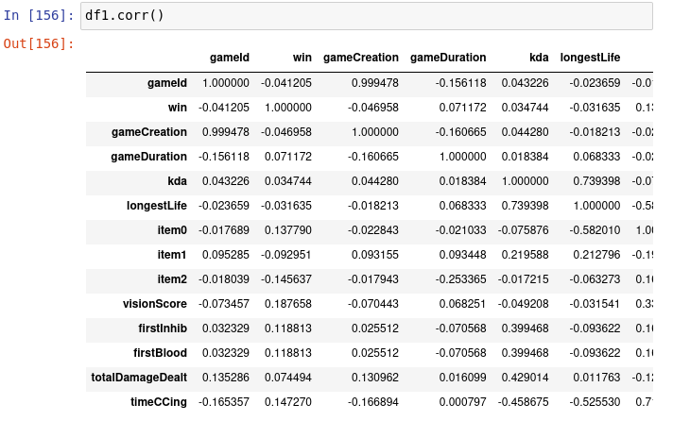
Let’s focus on the Win row and choose some promising columns
Here is a table showing correlation coefficients (R-Squared)

Slide 12
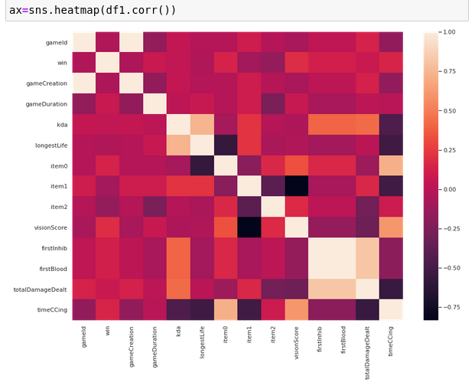
Heatmap of aforementioned table

Slide 13
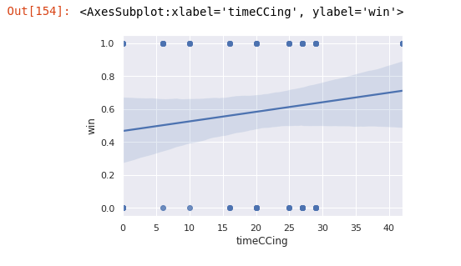
R² = 0.147

Slide 14
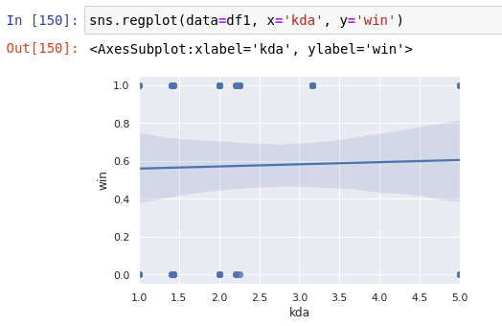
R² = 0.035

Slide 15
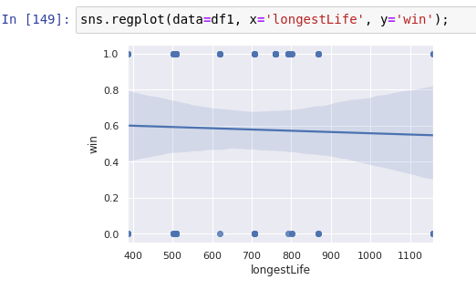
R² = -0.032

Slide 16
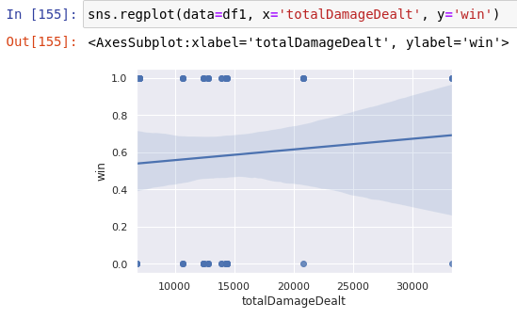
R² = 0.074

Slide 17
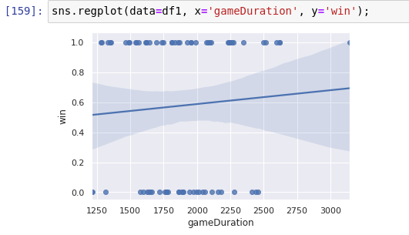
R² = 0.071

Slide 18
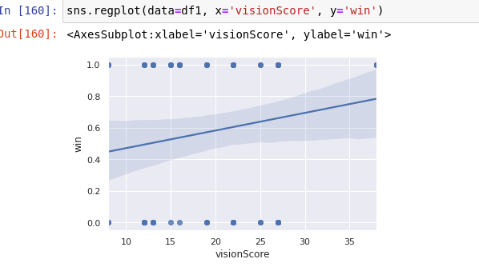
R² = 0.147

